Slide 1

Network Layer: Control Plane
Computer Networks
introduction
routing algorithms
link state
distance vector
intra-ISP routing: OSPF
routing among ISPs: BGP
SDN control plane
Internet Control Message Protocol
Network management, configuration

Slide 2
















Routing algorithm
mobile network
Routing algorithm goal: determine “good” paths (equivalently, routes), from sending hosts to receiving host, through network of routers
path: sequence of routers packets traverse from given initial source host to final destination host
“good”: least “cost”, “fastest”, “least congested”
routing: a “top-10” networking challenge!
national or global ISP
application
transport
network
link
physical
network
link
physical
network
link
physical
network
link
physical
network
link
physical
network
link
physical
datacenter
network
application
transport
network
link
physical
enterprise
network

Slide 3
Graph abstraction: link costs
5
c_{a,b}: cost of direct link connecting a and b
e.g., c_{w,z} = 5, c_{u,z} = ∞
cost defined by network operator: could always be 1, or inversely related to bandwidth, or related to congestion
v
3
w
2
5
u
2
1
z
3
1
2
x
y
1
graph: G = (N,E)
N: set of routers = { u, v, w, x, y, z }
E: set of links ={ (u,v), (u,x), (v,x), (v,w), (x,w), (x,y), (w,y), (w,z), (y,z) }

Slide 4
Routing algorithm classification
global: all routers have complete topology, link cost info
“link state” algorithms
dynamic: routes change more quickly
periodic updates or in response to link cost changes
How fast do routes change?
static: routes change slowly over time
decentralized: iterative process of computation, exchange of info with neighbors
routers initially only know link costs to attached neighbors
“distance vector” algorithms
global or decentralized information?

Slide 5

Network layer: “control plane” roadmap
introduction
routing protocols
link state
distance vector
intra-ISP routing: OSPF
routing among ISPs: BGP
SDN control plane
Internet Control Message Protocol
network management, configuration
SNMP
NETCONF/YANG

Slide 6
Dijkstra’s link-state routing algorithm
centralized: network topology, link costs known to all nodes
accomplished via “link state broadcast”
all nodes have same info
computes least cost paths from one node (“source”) to all other nodes
gives forwarding table for that node
iterative: after k iterations, know least cost path to k destinations
notation
C_{a,b}: direct link cost from node a to b; = ∞ if not direct neighbors
D(a): current estimate of cost of least-cost-path from source to destination a
p(a): predecessor node along path from source to a
N': set of nodes whose least-cost-path definitively known

Slide 7
Dijkstra’s link-state routing algorithm
1 Initialization:
2 N' = {u} /* compute least cost path from u to all other nodes */
3 for all nodes a
4 if a adjacent to u /* u initially knows direct-path-cost only to direct neighbors */
5 then D(a) = c_{u,a} /* but may not be minimum cost! */
6 else D(a) = ∞
7
8 Loop
9
10
11
12
13
14
15 until all nodes in N'
find a not in N' such that D(a) is a minimum
add a to N'
update D(b) for all b adjacent to a and not in N' :
D(b) = min ( D(b), D(a) + c_{a,b} )
/* new least-path-cost to b is either old least-cost-path to b or known
least-cost-path to a plus direct-cost from a to b */

Slide 8
Dijkstra’s algorithm: an example
v
w
x
y
z
Step
0
1
2
3
4
5
N'
D(v),p(v)
D(w),p(w)
D(x),p(x)
D(y),p(y)
D(z),p(z)
u
2,u
5,u
1,u
∞
∞
D(w),p(w)
5,u
4,x
3,y
3,y
5
Initialization (step 0):
For all a: if a adjacent to u then D(a) = c_{u,a}
v
3
w
2
5
u
2
1
z
3
1
2
x
y
1

Slide 9
Dijkstra’s algorithm: an example
v
w
x
y
z
Step
0
1
2
3
4
5
N'
D(v),p(v)
D(w),p(w)
D(x),p(x)
D(y),p(y)
D(z),p(z)
u
2,u
5,u
1,u
∞
∞
ux
D(w),p(w)
5,u
4,x
3,y
3,y
8 Loop
9
10
find a not in N' such that D(a) is a minimum
add a to N'
5
v
3
w
2
5
u
2
1
z
3
1
2
x
y
1

Slide 10

Dijkstra’s algorithm: an example
v
w
x
y
z
Step
0
1
2
3
4
5
N'
D(v),p(v)
D(w),p(w)
D(x),p(x)
D(y),p(y)
D(z),p(z)
u
2,u
5,u
1,u
∞
∞
ux
2,u
4,x
2,x
∞
D(w),p(w)
5,u
4,x
3,y
3,y
8 Loop
9
10
11
find a not in N' such that D(a) is a minimum
add a to N'
5
v
3
w
2
5
update D(b) for all b adjacent to a and not in N' :
D(b) = min ( D(b), D(a) + c_{a,b} )
u
2
1
z
3
1
2
D(v) = min ( D(v), D(x) + c_{x,v} ) = min(2, 1+2) = 2
x
y
1
D(w) = min ( D(w), D(x) + c_{x,w} ) = min (5, 1+3) = 4
D(y) = min ( D(y), D(x) + c_{x,y} ) = min(inf,1+1) = 2

Slide 11
Dijkstra’s algorithm: an example
v
w
x
y
z
Step
0
1
2
3
4
5
N'
D(v),p(v)
D(w),p(w)
D(x),p(x)
D(y),p(y)
D(z),p(z)
u
2,u
5,u
1,u
∞
∞
ux
2,u
4,x
2,x
∞
uxy
D(w),p(w)
5,u
4,x
3,y
3,y
8 Loop
9
10
find a not in N' such that D(a) is a minimum
add a to N'
5
v
3
w
2
5
u
2
1
z
3
1
2
x
y
1

Slide 12
Dijkstra’s algorithm: an example
v
w
x
y
z
Step
0
1
2
3
4
5
N'
D(v),p(v)
D(w),p(w)
D(x),p(x)
D(y),p(y)
D(z),p(z)
u
2,u
5,u
1,u
∞
∞
ux
2,u
4,x
2,x
∞
uxy
2,u
3,y
4,y
8 Loop
9
10
11
find a not in N' such that D(a) is a minimum
add a to N'
5
v
3
w
2
5
update D(b) for all b adjacent to a and not in N' :
D(b) = min ( D(b), D(a) + c_{a,b} )
u
2
1
z
3
1
2
D(w) = min ( D(w), D(y) + c_{y,w} ) = min (4, 2+1) = 3
x
y
1
D(z) = min ( D(z), D(y) + c_{y,x} ) = min(inf,2+2) = 4

Slide 13
Dijkstra’s algorithm: an example
v
w
x
y
z
Step
0
1
2
3
4
5
N'
D(v),p(v)
D(w),p(w)
D(x),p(x)
D(y),p(y)
D(z),p(z)
u
2,u
5,u
1,u
∞
∞
ux
2,u
4,x
2,x
∞
uxy
2,u
3,y
4,y
uxyv
8 Loop
9
10
find a not in N' such that D(a) is a minimum
add a to N'
5
v
3
w
2
5
u
2
1
z
3
1
2
x
y
1

Slide 14
Dijkstra’s algorithm: an example
v
w
x
y
z
Step
0
1
2
3
4
5
N'
D(v),p(v)
D(w),p(w)
D(x),p(x)
D(y),p(y)
D(z),p(z)
u
2,u
5,u
1,u
∞
∞
ux
2,u
4,x
2,x
∞
uxy
2,u
3,y
4,y
uxyv
3,y
4,y
8 Loop
9
10
11
find a not in N' such that D(a) is a minimum
add a to N'
5
v
3
w
2
5
update D(b) for all b adjacent to a and not in N' :
D(b) = min ( D(b), D(a) + c_{a,b} )
u
2
1
z
3
1
2
D(w) = min ( D(w), D(v) + c_{v,w} ) = min (3, 2+3) = 3
x
y
1

Slide 15
Dijkstra’s algorithm: an example
v
w
x
y
z
Step
0
1
2
3
4
5
N'
D(v),p(v)
D(w),p(w)
D(x),p(x)
D(y),p(y)
D(z),p(z)
u
2,u
5,u
1,u
∞
∞
ux
2,u
4,x
2,x
∞
uxy
2,u
3,y
4,y
uxyv
3,y
4,y
uxyvw
8 Loop
9
10
find a not in N' such that D(a) is a minimum
add a to N'
5
v
3
w
2
5
u
2
1
z
3
1
2
x
y
1

Slide 16
Dijkstra’s algorithm: an example
v
w
x
y
z
Step
0
1
2
3
4
5
N'
D(v),p(v)
D(w),p(w)
D(x),p(x)
D(y),p(y)
D(z),p(z)
u
2,u
5,u
1,u
∞
∞
ux
2,u
4,x
2,x
∞
uxy
2,u
3,y
4,y
uxyv
3,y
4,y
uxyvw
4,y
8 Loop
9
10
11
find a not in N' such that D(a) is a minimum
add a to N'
5
v
3
w
2
5
update D(b) for all b adjacent to a and not in N' :
D(b) = min ( D(b), D(a) + c_{a,b} )
u
2
1
z
3
1
2
D(z) = min ( D(z), D(w) + c_{w,z} ) = min (4, 3+5) = 4
x
y
1

Slide 17
Dijkstra’s algorithm: an example
v
w
x
y
z
Step
0
1
2
3
4
5
N'
D(v),p(v)
D(w),p(w)
D(x),p(x)
D(y),p(y)
D(z),p(z)
u
2,u
5,u
1,u
∞
∞
ux
2,u
4,x
2,x
∞
uxy
2,u
3,y
4,y
uxyv
3,y
4,y
uxyvw
4,y
uxyvwz
8 Loop
9
10
find a not in N' such that D(a) is a minimum
add a to N'
5
v
3
w
2
5
u
2
1
z
3
1
2
x
y
1

Slide 18
Dijkstra’s algorithm: an example
v
w
x
y
z
Step
0
1
2
3
4
5
N'
D(v),p(v)
D(w),p(w)
D(x),p(x)
D(y),p(y)
D(z),p(z)
u
2,u
5,u
1,u
∞
∞
ux
2,u
4,x
2,x
∞
uxy
2,u
3,y
4,y
uxyv
3,y
4,y
uxyvw
4,y
uxyvwz
8 Loop
9
10
11
find a not in N' such that D(a) is a minimum
add a to N'
5
v
3
w
2
5
update D(b) for all b adjacent to a and not in N' :
D(b) = min ( D(b), D(a) + c_{a,b} )
u
2
1
z
3
1
2
x
y
1

Slide 19
Dijkstra’s algorithm: an example
5
v
3
w
2
5
u
2
1
z
3
1
2
D(w),p(w)
5,u
4,x
3,y
3,y
x
y
1
resulting least-cost-path tree from u:
resulting forwarding table in u:
v
w
destination
outgoing link
v
x
y
w
z
(u,v)
(u,x)
(u,x)
(u,x)
(u,x)
route from u to v directly
u
z
x
route from u to all other destinations via x
y

Slide 20
Dijkstra’s algorithm: another example
v
w
x
y
z
x
D(v),
p(v)
D(w),
p(w)
D(x),
p(x)
D(y),
p(y)
D(z),
p(z)
9
Step
N'
0
u
7,u
3,u
5,u
∞
∞
5
7
4
1
uw
6,w
5,u
11,w
∞
8
2
uwx
6,w
11,w
14,x
u
3
w
y
z
2
3
uwxv
10,v
14,x
3
4
uwxvy
12,y
7
4
5
uwxvyz
v
notes:
construct least-cost-path tree by tracing predecessor nodes
ties can exist (can be broken arbitrarily)

Slide 21
Dijkstra’s algorithm: discussion
algorithm complexity: n nodes
each of n iteration: need to check all nodes, w, not in N
n(n+1)/2 comparisons: O(n²) complexity
more efficient implementations possible: O(nlogn)
message complexity:
each router must broadcast its link state information to other n routers
efficient (and interesting!) broadcast algorithms: O(n) link crossings to disseminate a broadcast message from one source
each router’s message crosses O(n) links: overall message complexity: O(n²)

Slide 22
Dijkstra’s algorithm: oscillations possible
when link costs depend on traffic volume, route oscillations possible
sample scenario:
routing to destination a, traffic entering at d, c, e with rates 1, e (<1), 1
link costs are directional, and volume-dependent
a
a
a
a
1
1+e
2+e
0
0
2+e
2+e
0
d
b
d
1
b
d
b
d
b
0
0
1+e
0
0
1+e
1
1
0
e
1
0
c
0
1
1
1
c
1+e
1
1
0
0
1
c
1
c
e
e
e
e
given these costs,
find new routing….
resulting in new costs
given these costs,
find new routing….
resulting in new costs
given these costs,
find new routing….
resulting in new costs
initially

Slide 23
Network Layer: Control Plane
Computer Networks
introduction
routing algorithms
link state
distance vector
intra-ISP routing: OSPF
routing among ISPs: BGP
SDN control plane
Internet Control Message Protocol
Network management, configuration

Slide 24
Distance vector algorithm
Based on Bellman-Ford (BF) equation (dynamic programming):
Bellman-Ford equation
Let D_{x}(y): cost of least-cost path from x to y.
Then:
D_{x}(y) = min_{v} { c_{x,v} + D_{v}(y) }
v’s estimated least-cost-path cost to y
min taken over all neighbors v of x
direct cost of link from x to v

Slide 25
Bellman-Ford Example
Suppose that u’s neighboring nodes, x,v,w, know that for destination z:
D_{v}(z) = 5
D_{w}(z) = 3
Bellman-Ford equation says:
5
D_{u}(z) = min { c_{u,v} + D_{v}(z),
c_{u,x} + D_{x}(z),
c_{u,w} + D_{w}(z) }
v
3
w
2
5
u
2
1
z
3
= min {2 + 5,
1 + 3,
5 + 3} = 4
1
2
x
y
1
D_{x}(z) = 3
node achieving minimum (x) is next hop on estimated least-cost path to destination (z)

Slide 26
Distance vector algorithm
key idea:
from time-to-time, each node sends its own distance vector estimate to neighbors
when x receives new DV estimate from any neighbor, it updates its own DV using B-F equation:
D_{x}(y) ← min_{v}{c_{x,v} + D_{v}(y)} for each node y ∊ N
under minor, natural conditions, the estimate D_{x}(y) converge to the actual least cost d_{x}(y)

Slide 27
Distance vector algorithm:
each node:
iterative, asynchronous: each local iteration caused by:
local link cost change
DV update message from neighbor
wait for (change in local link cost or msg from neighbor)
recompute my DV estimates using DV received from neighbor
distributed, self-stopping: each node notifies neighbors only when its DV changes
neighbors then notify their neighbors – only if necessary
no notification received, no actions taken!
if my DV to any destination has changed, send my new DV my neighbors, else do nothing.

Slide 28
Distance vector: example
DV in a: D_{a}(a)=0
D_{a}(b) = 8
D_{a}(c) = ∞
D_{a}(d) = 1
D_{a}(e) = ∞
D_{a}(f) = ∞
D_{a}(g) = ∞
D_{a}(h) = ∞
D_{a}(i) = ∞
a
b
c
8
1
t=0
1
1
All nodes have distance estimates to nearest neighbors (only)
A few asymmetries:
missing link
larger cost
d
e
f
1
1
All nodes send their local distance vector to their neighbors
1
1
1
g
h
i
1
1

Slide 29
Distance vector example: iteration
a
b
c
8
1
t=1
1
1
All nodes:
receive distance vectors from neighbors
compute their new local distance vector
send their new local distance vector to neighbors
d
e
f
1
1
1
1
1
g
h
i
1
1

Slide 30
Distance vector example: iteration
a
compute
compute
compute
b
c
8
1
t=1
1
1
All nodes:
receive distance vectors from neighbors
compute their new local distance vector
send their new local distance vector to neighbors
d
compute
e
f
compute
compute
1
1
1
1
1
g
h
i
compute
compute
1
compute
1

Slide 31
Distance vector example: iteration
a
b
c
8
1
t=1
1
1
All nodes:
receive distance vectors from neighbors
compute their new local distance vector
send their new local distance vector to neighbors
d
e
f
1
1
1
1
1
g
h
i
1
1

Slide 32
Distance vector example: iteration
a
b
c
8
1
t=2
1
1
All nodes:
receive distance vectors from neighbors
compute their new local distance vector
send their new local distance vector to neighbors
d
e
f
1
1
1
1
1
g
h
i
1
1

Slide 33
Distance vector example: iteration
compute
compute
compute
a
b
c
2
1
t=2
1
1
All nodes:
receive distance vectors from neighbors
compute their new local distance vector
send their new local distance vector to neighbors
d
compute
compute
compute
e
f
1
1
1
1
1
g
compute
compute
compute
h
i
8
1

Slide 34
Distance vector example: iteration
a
b
c
8
1
t=2
1
1
All nodes:
receive distance vectors from neighbors
compute their new local distance vector
send their new local distance vector to neighbors
d
e
f
1
1
1
1
1
g
h
i
1
1

Slide 35
Distance vector example: iteration
…. and so on
Let’s next take a look at the iterative computations at nodes

Slide 36
Distance vector example: computation
DV in b:
DV in c:
D_{c}(a) = ∞
D_{c}(b) = 1
D_{c}(c) = 0
D_{c}(d) = ∞
D_{c}(e) = ∞
D_{c}(f) = ∞
D_{c}(g) = ∞
D_{c}(h) = ∞
D_{c}(i) = ∞
D_{b}(a) = 8
D_{b}(c) = 1
D_{b}(d) = ∞
D_{b}(e) = 1
D_{b}(f) = ∞
D_{b}(g) = ∞
D_{b}(h) = ∞
D_{b}(i) = ∞
DV in a: D_{a}(a)=0
D_{a}(b) = 8
D_{a}(c) = ∞
D_{a}(d) = 1
D_{a}(e) = ∞
D_{a}(f) = ∞
D_{a}(g) = ∞
D_{a}(h) = ∞
D_{a}(i) = ∞
a
b
c
8
1
t=1
t=0
1
1
b receives DVs from a, c, e
DV in e:
D_{e}(a) = ∞
D_{e}(b) = 1
D_{e}(c) = ∞
D_{e}(d) = 1
D_{e}(e) = 0
D_{e}(f) = 1
D_{e}(g) = ∞
D_{e}(h) = 1
D_{e}(i) = ∞
d
e
f
1
1
1
1
1
g
h
i
1
1

Slide 37
Distance vector example: computation
DV in b:
DV in c:
D_{c}(a) = ∞
D_{c}(b) = 1
D_{c}(c) = 0
D_{c}(d) = ∞
D_{c}(e) = ∞
D_{c}(f) = ∞
D_{c}(g) = ∞
D_{c}(h) = ∞
D_{c}(i) = ∞
D_{b}(a) = 8
D_{b}(c) = 1
D_{b}(d) = ∞
D_{b}(e) = 1
D_{b}(f) = ∞
D_{b}(g) = ∞
D_{b}(h) = ∞
D_{b}(i) = ∞
DV in a: D_{a}(a)=0
D_{a}(b) = 8
D_{a}(c) = ∞
D_{a}(d) = 1
D_{a}(e) = ∞
D_{a}(f) = ∞
D_{a}(g) = ∞
D_{a}(h) = ∞
D_{a}(i) = ∞
a
b
c
b
8
compute
1
t=1
1
1
b receives DVs from a, c, e, computes:
DV in e:
D_{e}(a) = ∞
D_{e}(b) = 1
D_{e}(c) = ∞
D_{e}(d) = 1
D_{e}(e) = 0
D_{e}(f) = 1
D_{e}(g) = ∞
D_{e}(h) = 1
D_{e}(i) = ∞
e
d
e
f
1
1
D_{b}(a) = min{c_{b,a}+D_{a}(a), c_{b,c} +D_{c}(a), c_{b,e}+D_{e}(a)} = min{8,∞,∞} = 8
D_{b}(c) = min{c_{b,a}+D_{a}(c), c_{b,c} +D_{c}(c), c _{b,e} +D_{e}(c)} = min{∞,1,∞} = 1
D_{b}(d) = min{c_{b,a}+D_{a}(d), c_{b,c} +D_{c}(d), c _{b,e} +D_{e}(d)} = min{9,2,∞} = 2
New DV in b
1
1
1
D_{b}(e) = min{c_{b,a}+D_{a}(e), c_{b,c} +D_{c}(e), c _{b,e} +D_{e}(e)} = min{∞,∞,1} = 1
DV in b:
D_{b}(f) = min{c_{b,a}+D_{a}(f), c_{b,c} +D_{c}(f), c _{b,e} +D_{e}(f)} = min{∞,∞,2} = 2
D_{b}(g) = min{c_{b,a}+D_{a}(g), c_{b,c} +D_{c}(g), c _{b,e}+D_{e}(g)} = min{∞, ∞, ∞} = ∞
D_{b}(a) = 8
D_{b}(c) = 1
D_{b}(d) = 2
D_{b}(e) = 1
D_{b}(f) =2
D_{b}(g) = ∞
D_{b}(h) = 2
D_{b}(i) = ∞
g
h
1
i
1
D_{b}(h) = min{c_{b,a}+D_{a}(h), c_{b,c} +D_{c}(h), c _{b,e}+D_{e}(h)} = min{∞, ∞, 2} = 2
D_{b}(i) = min{c_{b,a}+D_{a}(i), c_{b,c} +D_{c}(i), c _{b,e}+D_{e}(i)} = min{∞, ∞, ∞} = ∞

Slide 38
Distance vector example: computation
DV in b:
DV in c:
D_{c}(a) = ∞
D_{c}(b) = 1
D_{c}(c) = 0
D_{c}(d) = ∞
D_{c}(e) = ∞
D_{c}(f) = ∞
D_{c}(g) = ∞
D_{c}(h) = ∞
D_{c}(i) = ∞
D_{b}(a) = 8
D_{b}(c) = 1
D_{b}(d) = ∞
D_{b}(e) = 1
D_{b}(f) = ∞
D_{b}(g) = ∞
D_{b}(h) = ∞
D_{b}(i) = ∞
DV in a: D_{a}(a)=0
D_{a}(b) = 8
D_{a}(c) = ∞
D_{a}(d) = 1
D_{a}(e) = ∞
D_{a}(f) = ∞
D_{a}(g) = ∞
D_{a}(h) = ∞
D_{a}(i) = ∞
a
b
c
8
1
t=1
1
1
c receives DVs from b
DV in e:
D_{e}(a) = ∞
D_{e}(b) = 1
D_{e}(c) = ∞
D_{e}(d) = 1
D_{e}(e) = 0
D_{e}(f) = 1
D_{e}(g) = ∞
D_{e}(h) = 1
D_{e}(i) = ∞
d
e
f
1
1
1
1
1
g
h
i
1
1

Slide 39
Distance vector example: computation
DV in b:
DV in c:
D_{c}(a) = ∞
D_{c}(b) = 1
D_{c}(c) = 0
D_{c}(d) = ∞
D_{c}(e) = ∞
D_{c}(f) = ∞
D_{c}(g) = ∞
D_{c}(h) = ∞
D_{c}(i) = ∞
D_{b}(a) = 8
D_{b}(c) = 1
D_{b}(d) = ∞
D_{b}(e) = 1
D_{b}(f) = ∞
D_{b}(g) = ∞
D_{b}(h) = ∞
D_{b}(i) = ∞
a
b
c
1
compute
8
t=1
1
1
c receives DVs from b computes:
New DV in c
d
e
f
D_{c}(a) = min{c_{c,b}+D_{b}(a}} = 1 + 8 = 9
DV in c:
D_{c}(a) = 9
D_{c}(b) = 1
D_{c}(c) = 0
D_{c}(d) = ∞
D_{c}(e) = 2
D_{c}(f) = ∞
D_{c}(g) = ∞
D_{c}(h) = ∞
D_{c}(i) = ∞
D_{c}(b) = min{c_{c,b}+D_{b}(b)} = 1 + 0 = 1
D_{c}(d) = min{c_{c,b}+D_{b}(d)} = 1+ ∞ = ∞
D_{c}(e) = min{c_{c,b}+D_{b}(e)} = 1 + 1 = 2
D_{c}(f) = min{c_{c,b}+D_{b}(f)} = 1+ ∞ = ∞
D_{c}(g) = min{c_{c,b}+D_{b}(g)} = 1+ ∞ = ∞
g
h
i
D_{c}(h) = min{c_{bc,b}+D_{b}(h)} = 1+ ∞ = ∞
D_{c}(i) = min{c_{c,b}+D_{b}(i)} = 1+ ∞ = ∞

Slide 40
Distance vector example: computation
DV in b:
D_{b}(a) = 8
D_{b}(c) = 1
D_{b}(d) = ∞
D_{b}(e) = 1
D_{b}(f) = ∞
D_{b}(g) = ∞
D_{b}(h) = ∞
D_{b}(i) = ∞
DV in e:
D_{e}(a) = ∞
D_{e}(b) = 1
D_{e}(c) = ∞
D_{e}(d) = 1
D_{e}(e) = 0
D_{e}(f) = 1
D_{e}(g) = ∞
D_{e}(h) = 1
D_{e}(i) = ∞
DV in d:
D_{c}(a) = 1
D_{c}(b) = ∞
D_{c}(c) = ∞
D_{c}(d) = 0
D_{c}(e) = 1
D_{c}(f) = ∞ D_{c}(g) = 1
D_{c}(h) = ∞
D_{c}(i) = ∞
a
b
c
8
1
t=1
Q: what is new DV computed in e at t=1?
1
1
e receives DVs from b, d, f, h
d
compute
f
DV in f:
D_{c}(a) = ∞
D_{c}(b) = ∞
D_{c}(c) = ∞
D_{c}(d) = ∞
D_{c}(e) = 1
D_{c}(f) = 0
D_{c}(g) = ∞
D_{c}(h) = ∞
D_{c}(i) = 1
e
DV in h:
D_{c}(a) = ∞
D_{c}(b) = ∞
D_{c}(c) = ∞
D_{c}(d) = ∞
D_{c}(e) = 1
D_{c}(f) = ∞
D_{c}(g) = 1
D_{c}(h) = 0
D_{c}(i) = 1
1
1
1
1
1
g
h
i
1
1

Slide 41
Distance vector: state information diffusion
Iterative communication, computation steps diffuses information through network:
t=0
c’s state at t=0 is at c only
a
b
c
8
1
c’s state at t=0 has propagated to b, and may influence distance vector computations up to 1 hop away, i.e., at b
t=1
1
1
t=1
t=2
c’s state at t=0 may now influence distance vector computations up to 2 hops away, i.e., at b and now at a, e as well
t=2
d
e
f
1
1
t=3
c’s state at t=0 may influence distance vector computations up to 3 hops away, i.e., at d, f, h
1
1
1
t=3
c’s state at t=0 may influence distance vector computations up to 4 hops away, i.e., at g, i
t=4
g
h
i
1
1
t=4

Slide 42
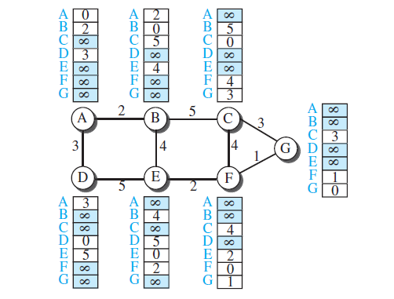
Initial Distance Vector for an internet in the Figure

Slide 43
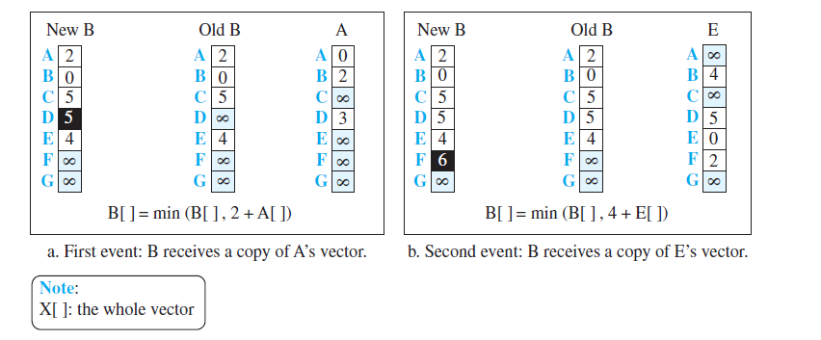
Updating Distance Vectors

Slide 44
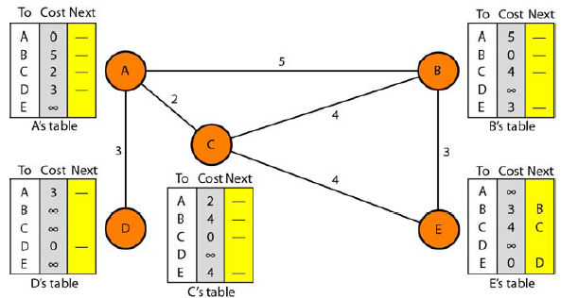
Distance Vector Routing:
Table Initialization

Slide 45
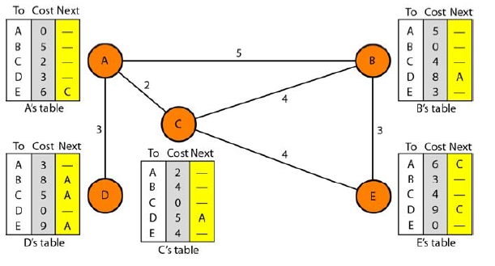
Distance Vector Routing: Sharing

Slide 46
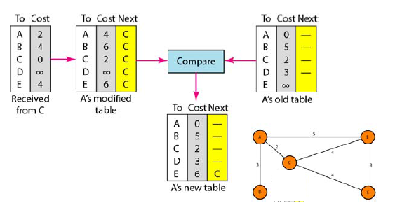
Distance Vector Routing: Updating
In distance vector routing, each node shares its routing table with its immediate neighbors periodically and when there is a change

Slide 47
Updating Routing Table
If the next-node entry is different
The receiving node chooses the row with the smaller cost
If there is a tie, the old one is kept
If the next-node entry is the same
i.e. the sender of the new row is the provider of the old entry
The receiving node chooses the new row, even though the new value is infinity.

Slide 48
When to Share
Periodic Update
A node sends its routing table, normally 30 seconds, in a periodic update
Triggered Update
A node sends its routing table to its neighbors any time when there is a change in its routing table
1. After updating its routing table, or
2. Detects some failure in the neighboring links

Slide 49
Distance vector: link cost changes
link cost changes:
node detects local link cost change
updates routing info, recalculates local DV
if DV changes, notify neighbors
1
y
4
1
x
z
50
t₀ : y detects link-cost change, updates its DV, informs its neighbors.
“good news
travels fast”
t₁ : z receives update from y, updates its DV, computes new least cost to x , sends its neighbors its DV.
t₂ : y receives z’s update, updates its DV. y’s least costs do not change, so y does not send a message to z.

Slide 50
Distance vector: link cost changes
link cost changes:
node detects local link cost change
“bad news travels slow” – count-to-infinity problem:
60
y
4
1
x
z
50
y sees direct link to x has new cost 60, but z has said it has a path at cost of 5. So, y computes “my new cost to x will be 6, via z); notifies z of new cost of 6 to x.
z learns that path to x via y has new cost 6, so z computes “my new cost to x will be 7 via y), notifies y of new cost of 7 to x.
y learns that path to x via z has new cost 7, so y computes “my new cost to x will be 8 via y), notifies z of new cost of 8 to x.
z learns that path to x via y has new cost 8, so z computes “my new cost to x will be 9 via y), notifies y of new cost of 9 to x.
…
see text for solutions. Distributed algorithms are tricky!

Slide 51
Count to Infinity
A problem with distance-vector routing is that
any decrease in cost (good news) propagates quickly,
but any increase in cost (bad news) will propagate slowly.
For a routing protocol to work properly, if a link is broken (cost becomes infinity),
every other router should be aware of it immediately,
but in distance-vector routing, this takes some time.
The problem is referred to as count to infinity
It sometimes takes several updates before the cost for a broken link is recorded as infinity by all routers.

Slide 52
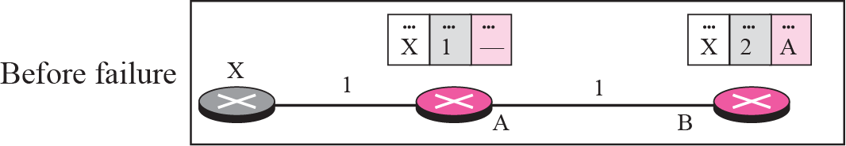
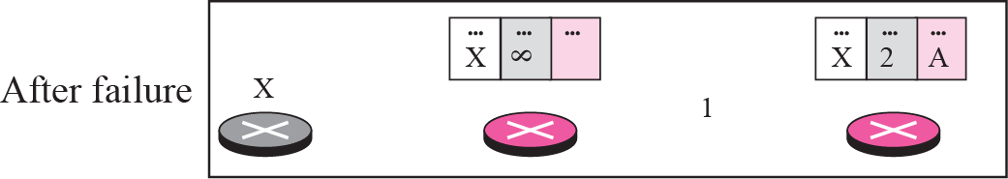
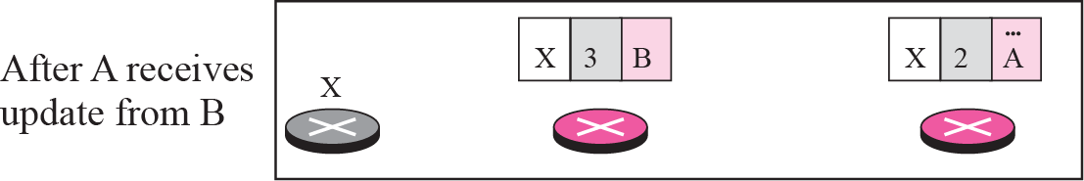
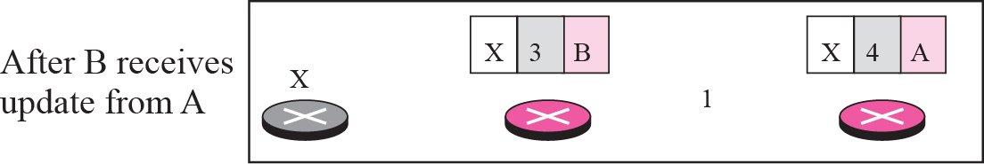
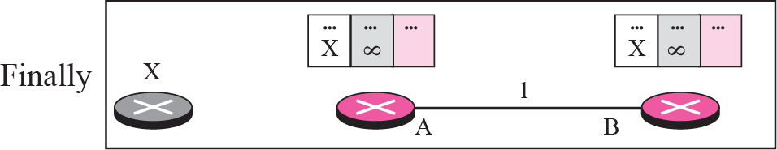
Count to Infinity: Two node loop
Most implementations define 16 as infinity

Slide 53
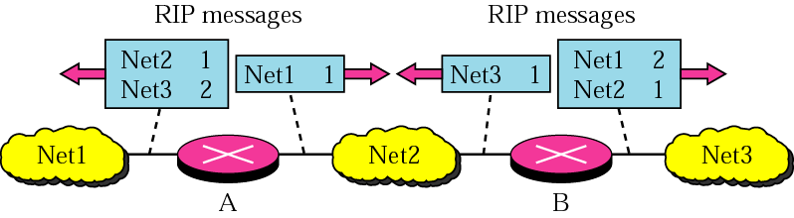
Solutions for Two-Node Instability
Split Horizon
Split horizon is a method of preventing a routing loop in a network.
Simple principle: Information about the routing for a particular packet is never sent back in the direction from which it was received.
So, instead of flooding the table through each interface, each node sends only part of its table through each interface

Slide 54
Comparison of LS and DV algorithms
message complexity
LS: n routers, O(n²) messages sent
DV: exchange between neighbors; convergence time varies
robustness: what happens if router malfunctions, or is compromised?
LS:
router can advertise incorrect link cost
each router computes only its own table
DV:
DV router can advertise incorrect path cost (“I have a really low-cost path to everywhere”): black-holing
each router’s DV is used by others: error propagate thru network
speed of convergence
LS: O(n²) algorithm, O(n²) messages
may have oscillations
DV: convergence time varies
may have routing loops
count-to-infinity problem

Slide 55
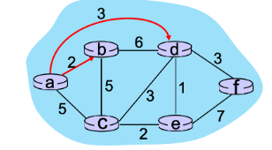
DIJKSTRA’S LINK-STATE ROUTING ALGORITHM.
Consider the graph shown below and the use of Dijkstra’s algorithm to compute a least cost path from a to all destinations. Suppose that nodes b and d have already been added to N’.
What is the next node to be added to N’?
What is the path cost to the next node to be added to N'

Slide 56
DIJKSTRA’S LINK-STATE ROUTING ALGORITHM.
Consider the graph shown below and the use of Dijkstra’s algorithm to compute a least cost path from a to all destinations. Suppose that nodes b and d have already been added to N’. What is the next node to be added to N’?

